Slide 1

ALY 3510 · Fall 2026
Lecture 7: Computer Vision
Teaching machines to see and understand images

Slide 2
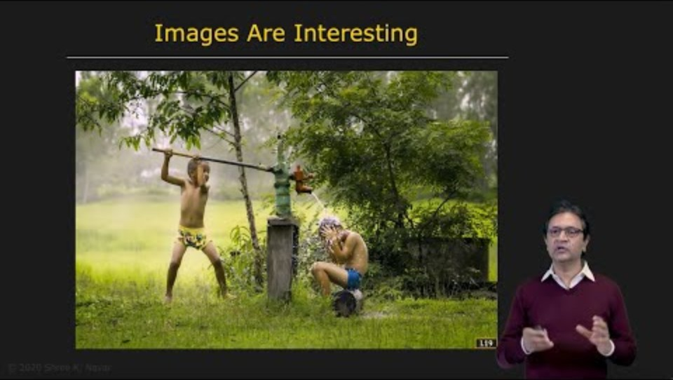
Pre-Lecture Video: What is Computer Vision? (7:33)
https://www.youtube.com/watch?v=wVE8SFMSBJ0

Slide 3
Agenda
Pre-lecture video
Lecture:
  What is Computer Vision?
  Image Acquisition & 3D Understanding
  From Pixels to Understanding
  Core Vision Tasks
  Video, Motion & Advanced Topics
  Real-World Impact
  Summary
BREAK (during the lecture)
Notes:
.

Slide 4
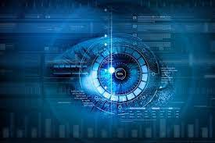

What is Computer Vision (CV)?
CV enables machines to understand visual information — images, video, and real-time sensor data.
Human vision
Computer vision
Instant recognition
Context and emotion
Effortless — but hard to introspect
Pixel arrays → patterns → meaning
Needs explicit models & data
Scales to millions of images
Vision dominates human perception:
~10 Mb/s of visual bandwidth to the brain¹ vs. ~39 b/s for speech² — roughly 250,000× more information.
1 Koch et al., Current Biology, 2006 (doi:10.1016/j.cub.2006.05.056)
2 Coupé et al., Science Advances, 2019 (doi:10.1126/sciadv.aaw2594)

Slide 5
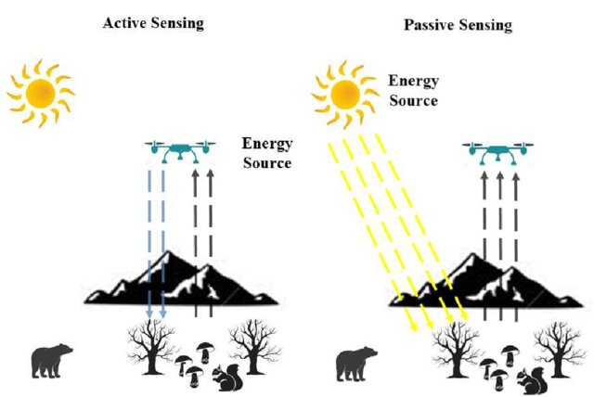
How We Capture Images
Active sensing
Passive sensing
Emits energy and measures reflection
LiDAR, structured light, time-of-flight
Enables depth & low-light perception
Captures ambient light reflected by objects
RGB cameras, thermal imaging, human vision

Slide 6
How We Understand Images
The three pillars of computer vision:
Features
Reconstruction
Recognition
Find distinctive patterns — edges, corners, textures, learned embeddings.
Recover 3D structure — depth, surfaces, point clouds.
Understand meaning — detect, classify, describe scenes.

Slide 7
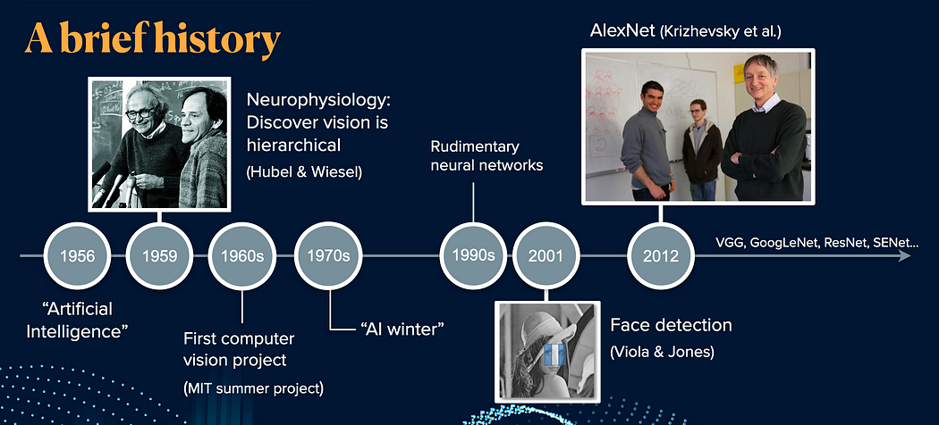
A Brief History of Computer Vision
Era | Approach | Milestone
1960s | Early research | Edge detection, pattern recognition
1980s | Computational vision | Marr’s vision theory, Canny edges, LeNet (1989)
2000s | Features + classical ML | SIFT, SURF, HOG + SVMs, Viola–Jones faces
2012+ | Deep learning | AlexNet on ImageNet → the deep-learning revolution
2012 was the turning point: AlexNet’s ImageNet win moved the field from hand-crafted features to learned ones.

Slide 8
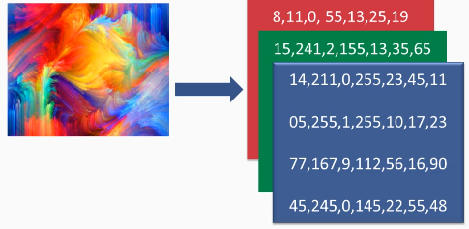
How Computers See Images
A digital image is just numbers — a grid of pixel values.
RGB color model: each pixel = Red, Green, Blue (each 0–255).
1080p image = 1920 × 1080 × 3 ≈ 6.2 million values.
CV transforms these raw pixel values into meaningful understanding.

Slide 9
Image Acquisition & 3D Understanding
From pixels to depth and geometry

Slide 10
Image Modalities: Many Ways to See
Modality | What it captures | Used for
RGB (2D) | Visible light | Everyday photos, video, surveillance
Infrared / thermal | Heat signatures | Night vision, security, wildlife
X-ray | See through objects | Medical, security screening
Depth sensors | Per-pixel distance | Robotics, AR/VR
CT / MRI (3D) | Cross-sectional volumes | Non-invasive diagnosis, surgery planning
1D line scan | One row at a time | Factory inspection, satellite imaging

Slide 11
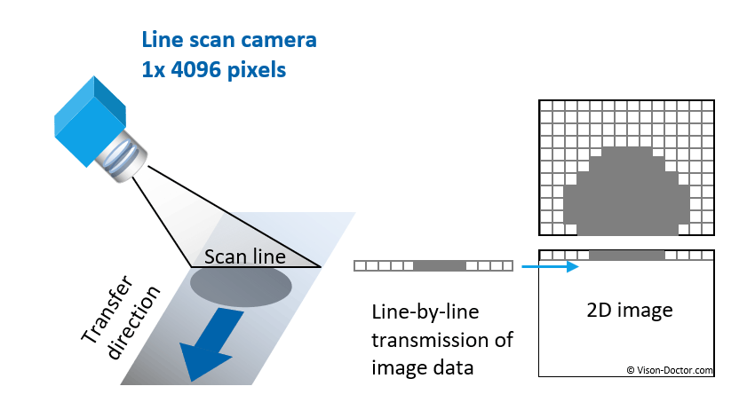

Image Modalities: 1D Line Scan
A single row of pixels captures an image as the object moves past the sensor
Line Scan Cameras
Advantages:
Very high resolution
Continuous imaging
No motion blur
Applications:
Factory inspection, document scanning, satellite imagery

Slide 12




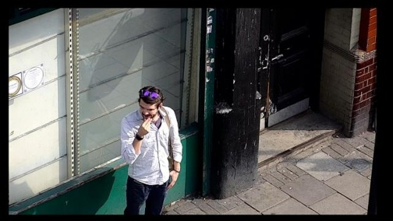
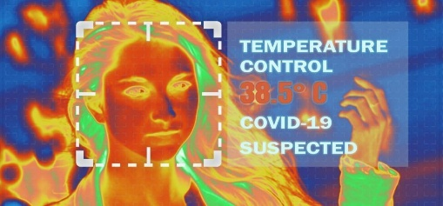
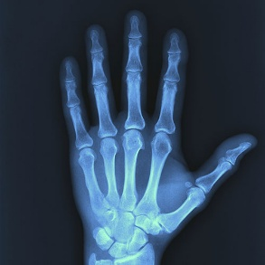
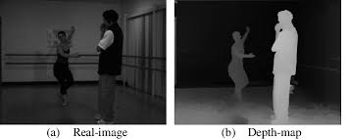
Image Modalities: 2D Sensors
RGB
Infrared
X-Ray
Depth (2.5D)
Visible Light
Thermal
Medical
Distance
Standard cameras, human-like vision
Heat signatures, night vision
See through objects, bones
Per-pixel depth values
Photos, video, surveillance
Security, wildlife
Healthcare, security
Robotics, AR/VR

Slide 13


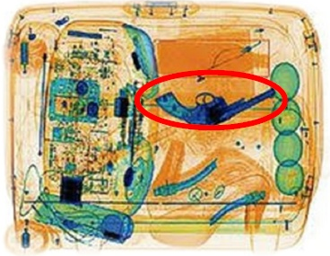
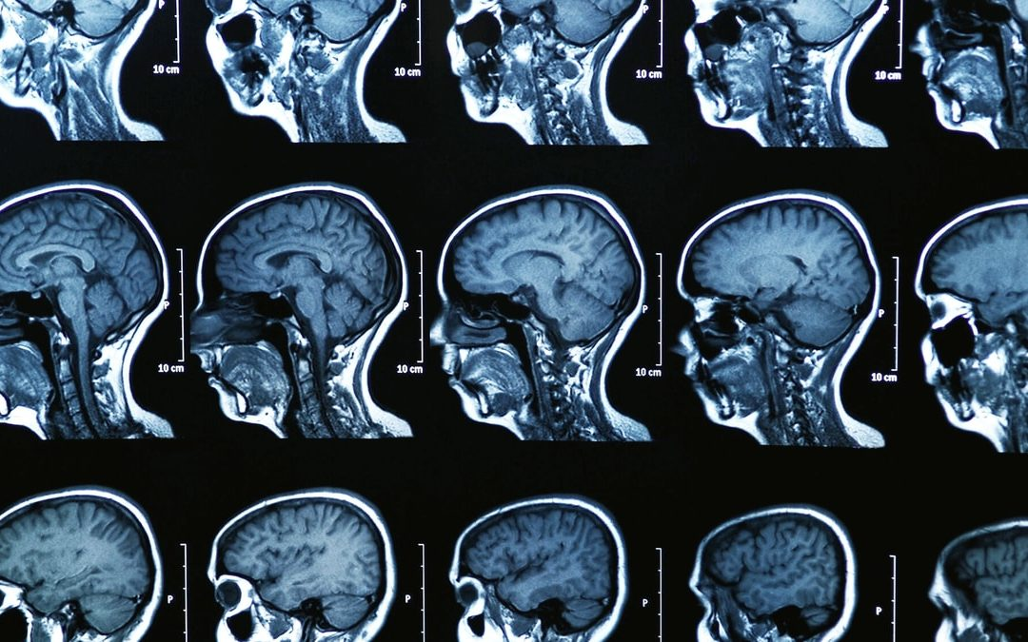
Image Modalities: 3D Imaging
CT Scan
MRI Scan
Computed Tomography
Magnetic Resonance
X-ray slices combined into a 3D volume
Radio waves and magnetic fields
Best For:
Best For:
Bones, lungs, tumors, internal bleeding, airport screening
Soft tissue, brain, spinal cord, joints
3D medical imaging enables non-invasive diagnosis and surgical planning

Slide 14
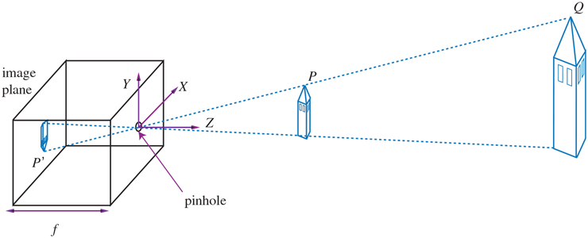
Camera Models: The Pinhole Camera
The simplest camera: light passes through a single point to form an inverted image.
No distortion, infinite depth of field, mathematically simple.
Key parameters: focal length, principal point, image dimensions.
Why it matters: the foundation for camera calibration, 3D reconstruction, and perspective.

Slide 15
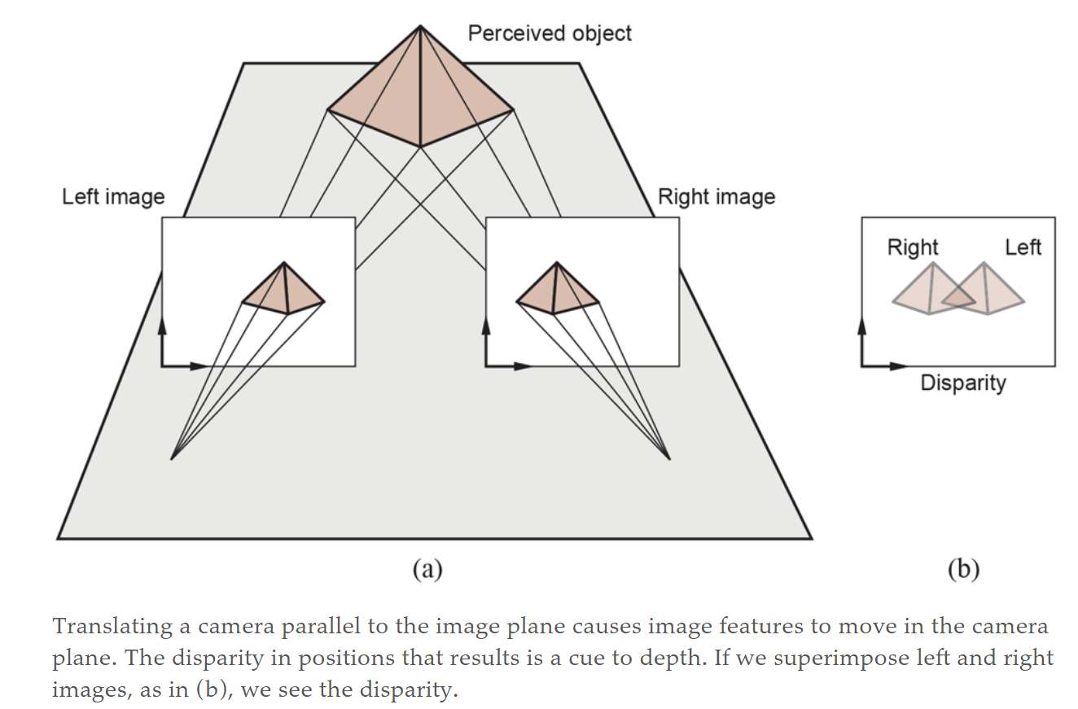
Depth Cues: Stereo, Motion & Structured Light
Stereo vision: two cameras; the disparity between views reveals depth (like human eyes).
Structure from motion: reconstruct 3D from many photos taken from different viewpoints.
Single-view cues: focus, texture gradient, shading hint at depth from one image.
Structured light: project a known pattern; measure its deformation to compute depth.
Stereo disparity: nearer objects shift more between the two views
Notes:
There are nine anchor boxes (three scales, three aspect ratios) at each grid point. For the example image, an inner green box and an outer blue box have passed the objectness test. The second network is a feature stack that computes a representation of the image suitable for classification. The boxes with highest objectness score are cut from the feature map, standardized in size with ROI pooling, and passed to a classifier. The blue box has a higher score than the green box and overlaps it, so the green box is rejected by non-maximum suppression. Finally, bounding box regression the blue box so that it fits the .

Slide 16

BREAK: How Computer Vision Works (7:07)
Watch for: Core CV pipeline, feature extraction, and real-world applications

Slide 17
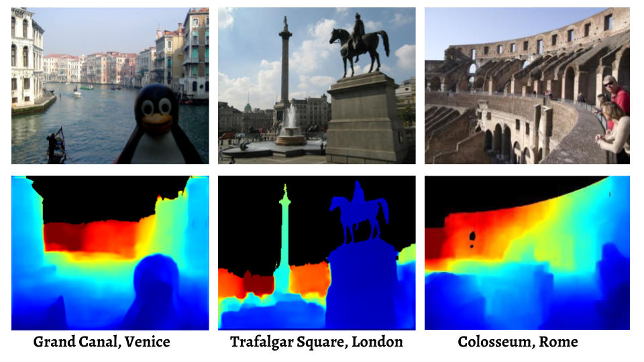
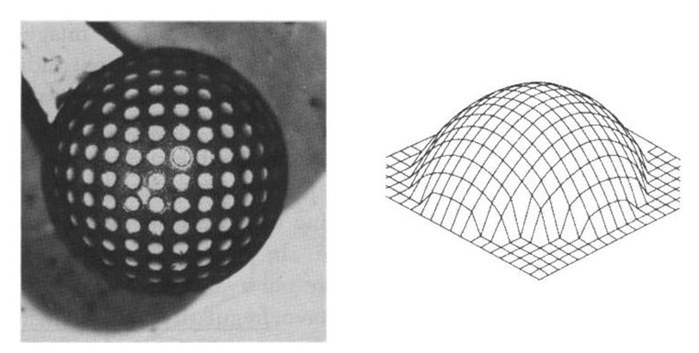
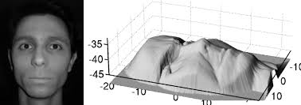
Single-View Depth Cues
Inferring depth from a single image using visual cues — no stereo pair required
Depth from Focus
Shape from Texture
Shape from Shading
Sharp regions are in focus; blur indicates distance from focal plane
Texture density changes with surface orientation and distance
Light and shadow patterns reveal surface curvature and orientation
Deep learning now combines these cues to predict depth from single images
Notes:
There are nine anchor boxes (three scales, three aspect ratios) at each grid point. For the example image, an inner green box and an outer blue box have passed the objectness test. The second network is a feature stack that computes a representation of the image suitable for classification. The boxes with highest objectness score are cut from the feature map, standardized in size with ROI pooling, and passed to a classifier. The blue box has a higher score than the green box and overlaps it, so the green box is rejected by non-maximum suppression. Finally, bounding box regression the blue box so that it fits the .

Slide 18
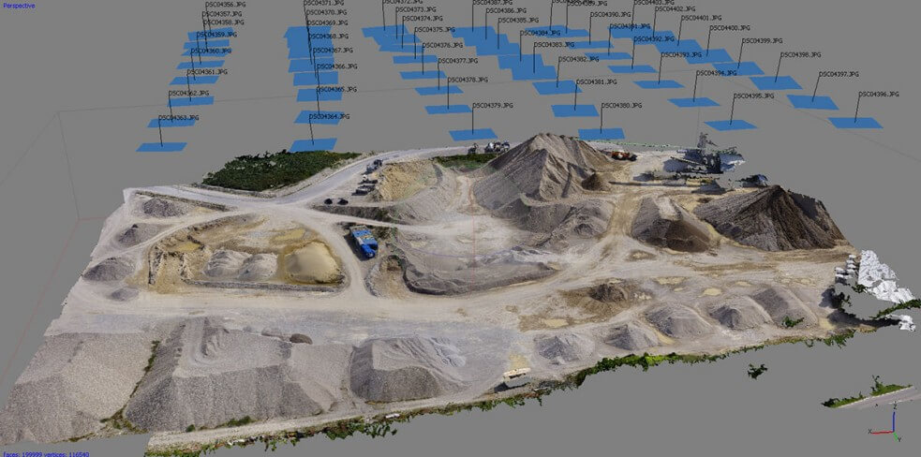
Scene Understanding: 3D Reconstruction
Structure from motion, photogrammetry
https://www.sculpteo.com/en/3d-learning-hub/3d-printing-software/photogrammetry-software/

Slide 19
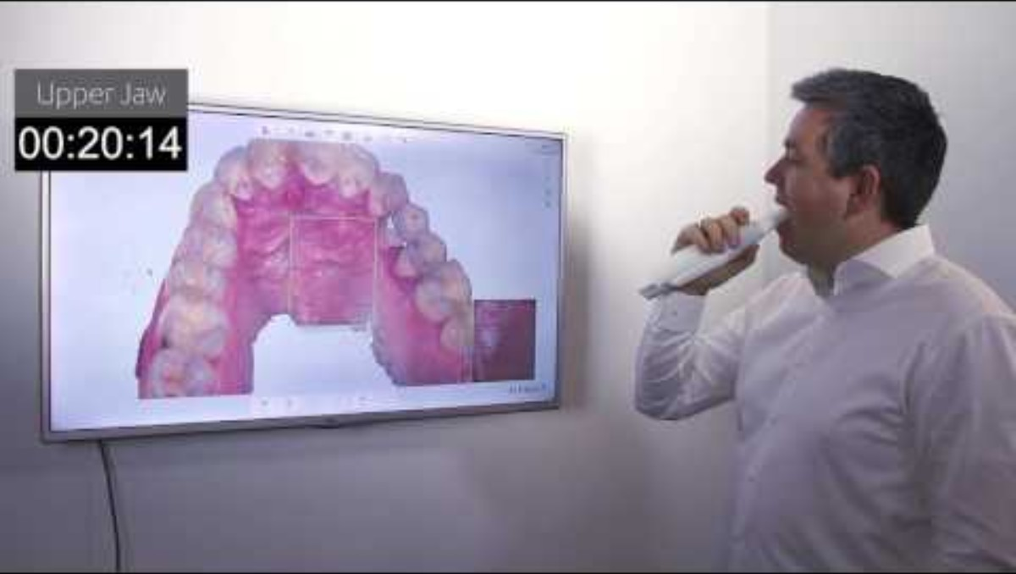
3D Reconstruction: (1:47)
Structure from motion: dentistry
https://www.youtube.com/watch?v=C5jKnxEyrbU

Slide 20
Structured Light 3D Scanning
Project known light patterns onto a scene and measure deformation to calculate depth
How It Works
Advantages
Projector emits pattern
Camera observes distortion
Triangulation gets depth
High accuracy
Dense depth maps
Works on texture-less surfaces
Pattern Types
Applications
Stripe patterns
Grid patterns
Dot patterns (Kinect)
Face ID / face authentication
Industrial inspection
Gaming (Xbox Kinect)

Slide 21
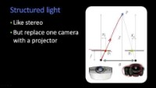
3D Reconstruction - Structured Light (2:08)
Active projection – structured light
https://www.youtube.com/watch?v=mSsnf5tqXnA

Slide 22
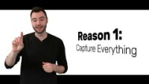
3D Reconstruction: Point Cloud (3:30)
Watch for: How laser scanning create dense 3D point clouds in real-time
https://www.youtube.com/watch?v=dlXF3CX0o2Y

Slide 23
From Pixels to Understanding
How deep learning transformed vision

Slide 24
Traditional ML → Deep Learning (CNNs)
CNNs (introduced in Lecture 4) automatically learn a hierarchy of visual features — the architecture that revolutionized vision. Traditional methods still help in constrained settings.
Traditional ML
Deep learning (CNNs)
Hand-crafted features + a classifier
Needs domain expertise
Interpretable; works with less data
Learns features end-to-end from data
Early layers: edges → deep layers: objects
Higher accuracy; needs large datasets
Features build up in a hierarchy:
low-level (edges, corners) → mid-level (shapes, parts) → high-level (objects, scenes).

Slide 25
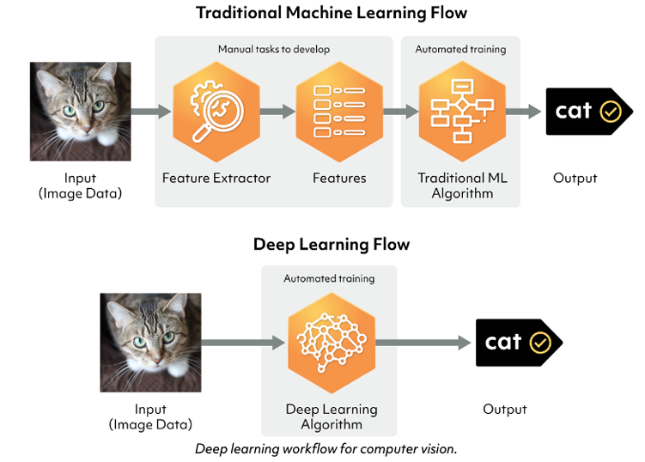
Machine Learning Powers Modern Vision
From Hand-Crafted Rules to Learning from Data
https://images.app.goo.gl/1CUiqojQiVfQeEd29

Slide 26
Core Vision Tasks
Classify, detect, segment, track

Slide 27
Core Computer Vision Tasks
Classification
Detection
Segmentation
What is in the image?
What objects, and where?
Label every pixel
Tracking
Recognition
Generation
Follow objects over time
Identify specific instances
Create new images

Slide 28
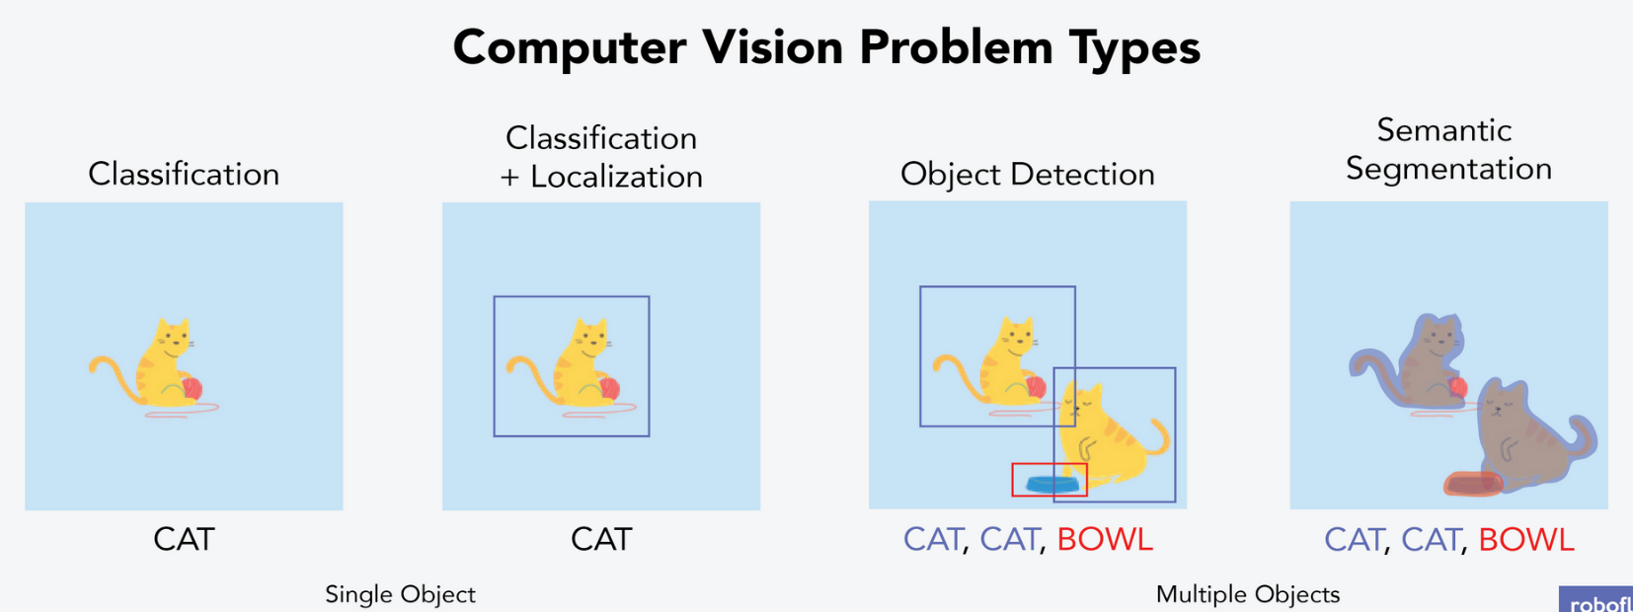
Classification → Localization → Detection → Segmentation
Task | Question | Output
Classification | What is it? | A single class label for the whole image
Localization | What + where? | One object: class label + bounding box
Detection | All instances? | Many objects: multiple labels + boxes
Segmentation | Which pixels? | A class for every pixel
Increasing complexity — from “what” to “what, where, and exactly which pixels.”

Slide 29
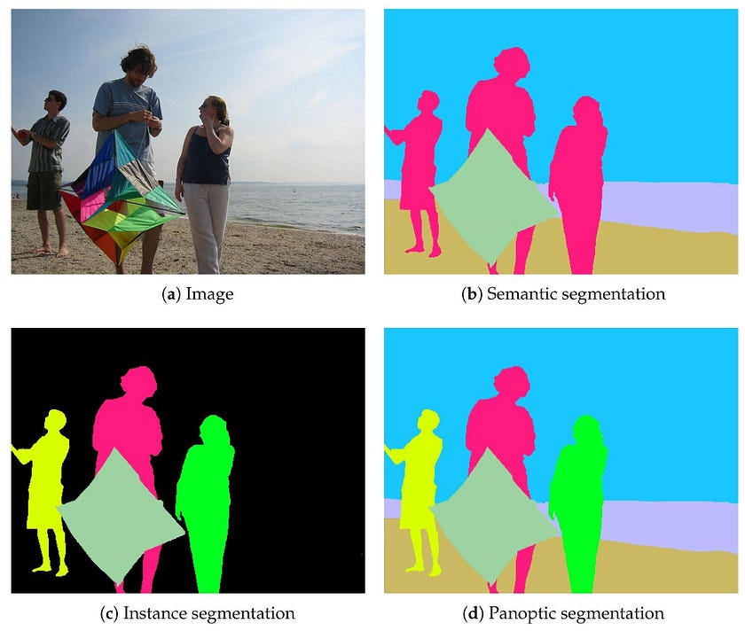
Segmentation: Types & Architectures
Key architectures: U-Net (semantic, works with limited data) · Mask R-CNN (instance segmentation).
Uses: medical imaging, autonomous driving.
Type | What it does
Semantic | Label each pixel by category (car, road, sky)
Instance | Separate individual objects of the same class
Panoptic | Both combined — full scene understanding
https://medium.com/@asmat.pucit/what-is-computer-vision-and-its-applications-in-real-world-e822ddf12cf0

Slide 30
Object Detection Architectures
Family | How it works | Trade-off
Two-stage (R-CNN, Faster R-CNN) | Propose regions, then classify each | Higher accuracy
One-stage (YOLO, SSD, RetinaNet) | Detect all objects in a single pass | Faster — real-time
Transformer (DETR) | End-to-end; no anchors, no NMS | Simpler pipeline; global reasoning
DETR (2020) brought the transformer idea from NLP into object detection;
The Vision Transformer (ViT) did the same for image classification that year.
Later DETR variants (Deformable DETR, DINO‑DETR, RT‑DETR) made it faster and more accurate.

Slide 31
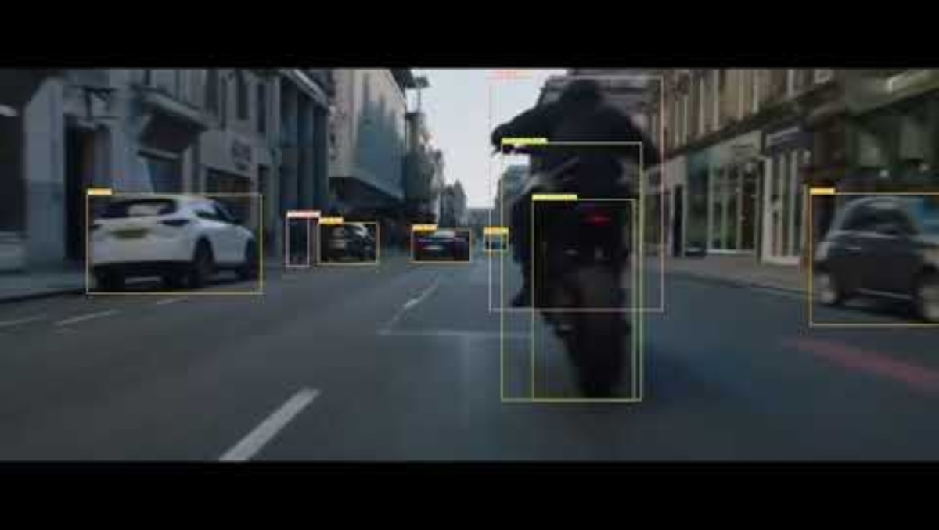
Transformer-Based Detection (Video 1:36)
https://www.youtube.com/watch?v=TbaLWroPYbo

Slide 32
Video, Motion & Advanced Topics
Beyond single images

Slide 33
Object Tracking & Motion Analysis
Applications: autonomous driving, sports analytics, surveillance, robotics.
Object tracking
Video understanding
Follow objects across frames, keeping identity
Single-object vs. multi-object (MOT)
Handle occlusion, re-identification
Optical flow estimates pixel movement
Motion detection (background subtraction)
Video tagging & captioning
Models: VideoBERT, CLIP4Caption, Vid2Seq

Slide 34
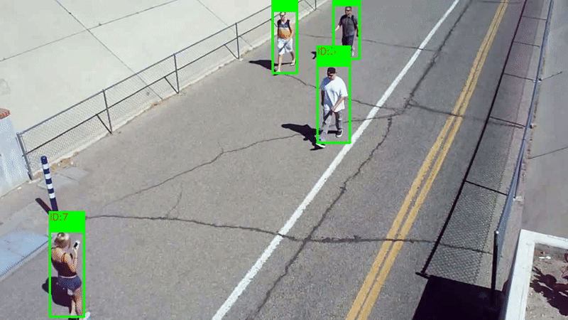
Object Tracking
Object tracking is a crucial application widely used in computer vision. It refers to the automatic recognition and tracing of objects across video frames.
https://www.comet.com/site/blog/an-introduction-to-object-tracking-in-computer-vision/

Slide 35
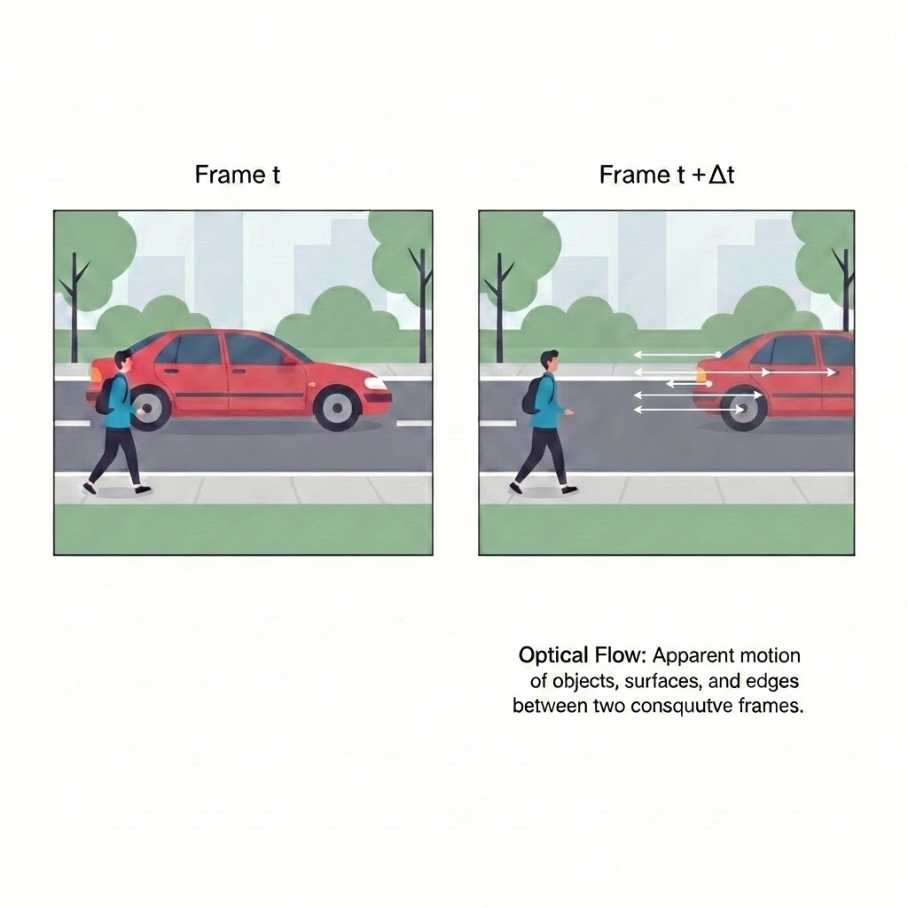
Motion Detection
Identifying and tracking movement across video frames
Techniques
Applications
Frame differencing
Security surveillance
Background subtraction
Traffic monitoring
Optical flow
Sports analytics
Deep learning methods
Autonomous vehicles
Key concept: Optical flow estimates pixel movement between consecutive frames

Slide 36
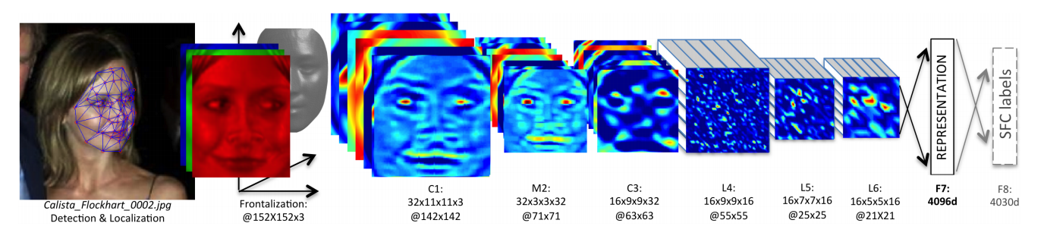
Pose Estimation & Face Recognition
Pose estimation: detect body keypoints to understand human movement.
Uses: fitness, sign-language recognition, animation/motion capture.
Models: OpenPose, MediaPipe.
Face recognition — detect → align → extract embedding → match against a database.
Verification (is this the same person?) vs. identification (who is this?).
Face-recognition pipeline (frontalize → convolutions → embedding).
https://www.researchgate.net/publication/357898559_Knock_Knock_Who%27s_There_Facial_Recognition_using_CNN-based_Classifiers/figures?lo=1

Slide 37
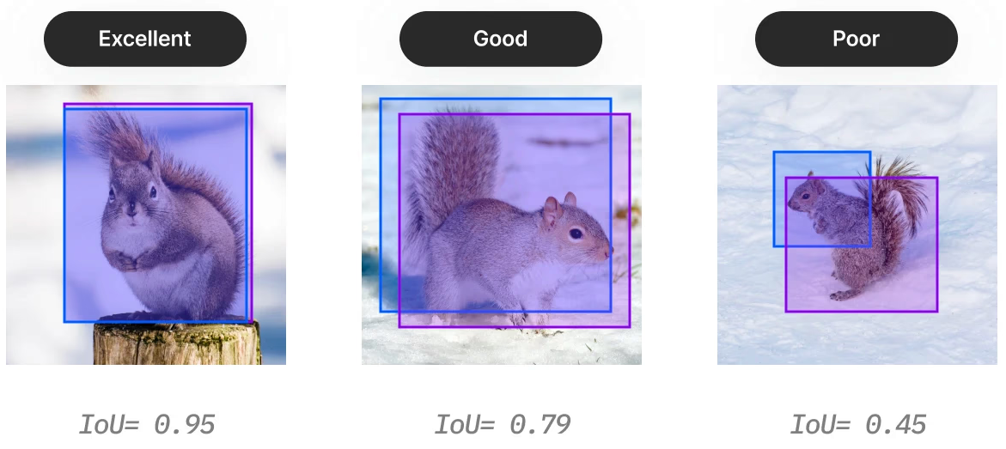
Evaluation Metrics
Standardized measures to assess model performance
Classification
Detection
Segmentation
Accuracy
Precision / Recall
F1 Score
IoU
mAP
AP@50, AP@75
Pixel Accuracy
Mean IoU (mIoU)
Dice Coefficient
Key: IoU = Intersection over Union; mAP = mean Average Precision

Slide 38
Image Generation & Vision-Language Models
These build on the generative and multimodal ideas from Lectures 4 & 6 — here applied to vision.
Image generation
Vision-language models
GANs — generator vs. discriminator
Diffusion — denoise random noise into images (state of the art)
Examples: GPT Image (ChatGPT), Nano Banana (Gemini), FLUX.2, Midjourney, Stable Diffusion
Understand images AND text together
CLIP — align image & text embeddings (zero-shot)
Research: CLIP, BLIP, LLaVA · Frontier: GPT-5, Gemini 3, Claude · Open: Qwen3-VL

Slide 39
Real-World Impact
Where computer vision is used today

Slide 40
Computer Vision Across Industries
Autonomous vehicles
Medical imaging
Industrial
Lane detection, object tracking, scene understanding.
Tumor detection, X-ray & pathology analysis.
Defect inspection, quality control, robotics.
Retail
AR / VR
Security & more
Cashier-less checkout, inventory, analytics (Amazon Go).
Overlay digital content; SLAM, hand & eye tracking.
Surveillance, agriculture, satellite imaging.

Slide 41
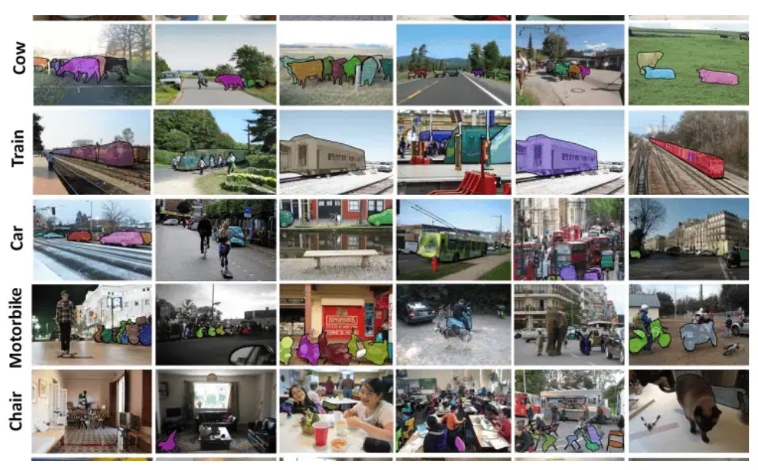
Datasets & Challenges
Datasets
Open challenges
COCO is the workhorse benchmark for detection, segmentation, and keypoint tasks.
ImageNet (classification), COCO (detection/seg), Pascal VOC
Robustness — lighting, weather, occlusion
Data bias & fairness across demographics
Adversarial examples; generalization

Slide 42
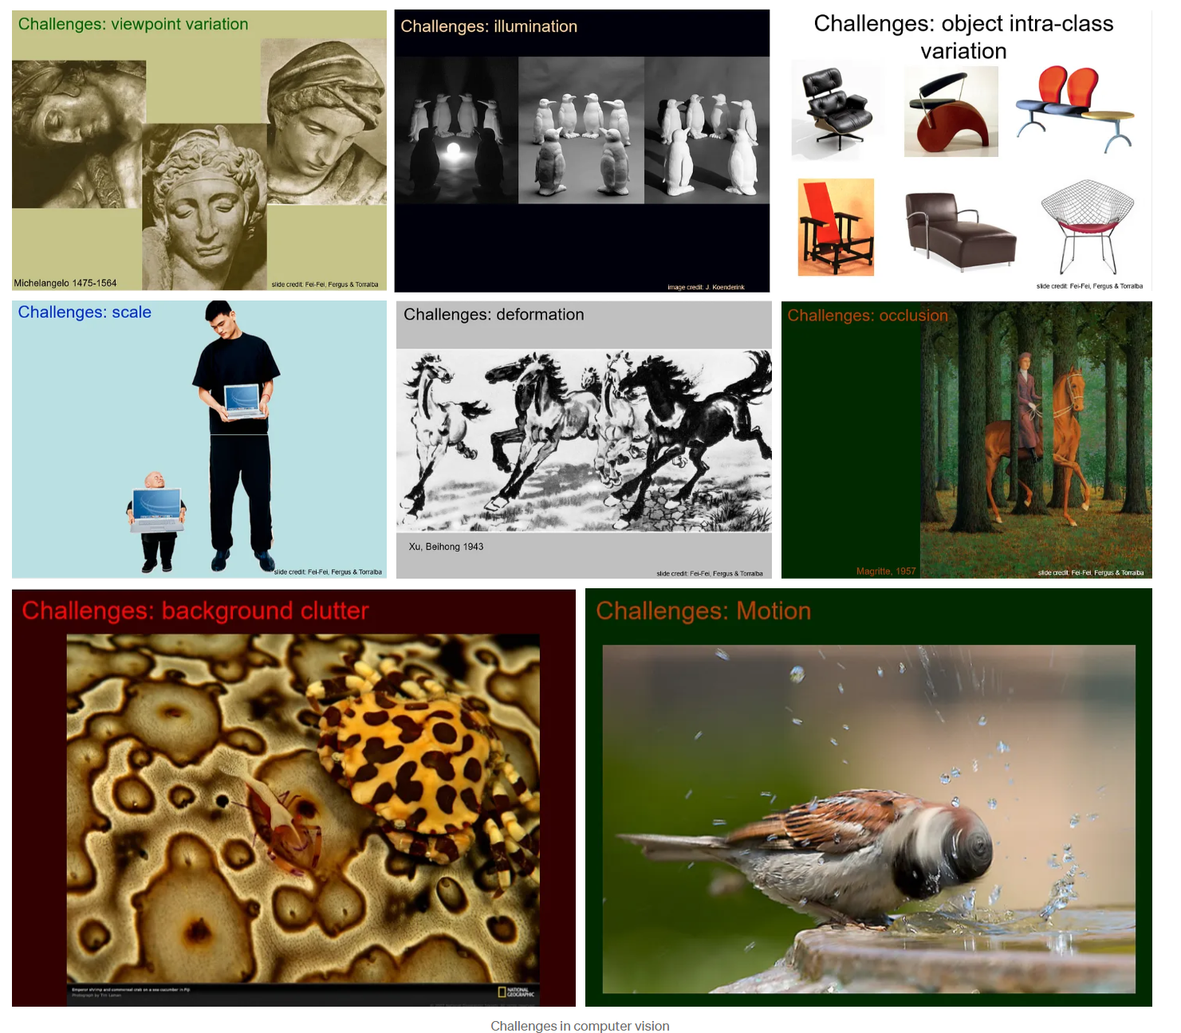
Challenges in Computer Vision

Slide 43
Ethics & Future Directions
The trend: unified models that see, hear, understand, and act in the physical world — built transparently and accountably.
Responsible CV
Where it’s heading
Bias & fairness — audit for demographic gaps
Privacy — face recognition, consent, GDPR, EU AI Act
Surveillance — risks of mass monitoring
Foundation models (SAM 3, DINOv3) — segment by text prompt, zero/few-shot
3D vision — neural radiance fields, Gaussian splatting
Embodied AI — vision for robotics & action

Slide 44
Summary

Slide 45
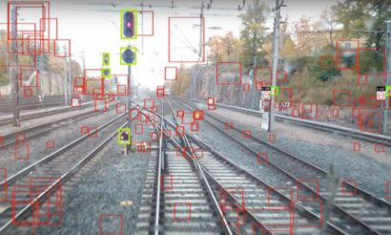
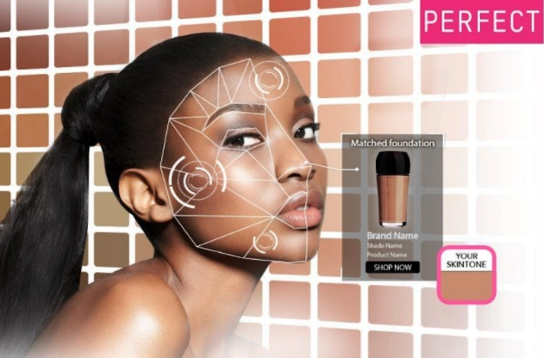
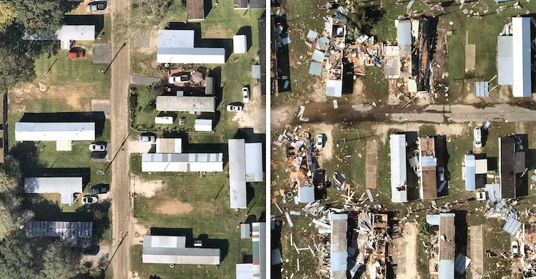
Key Takeaways
CV extracts meaning from pixels Images are numbers; models turn them into understanding.
Geometry recovers 3D Stereo, motion, and active sensing infer depth from 2D.
CNNs & transformers power modern vision Learned features replaced hand-crafted ones after 2012.
Core tasks: classify, detect, segment, track, generate Increasing complexity from ‘what’ to ‘exactly which pixels.’
Ethics matter Address bias, privacy, and surveillance from the start.

Slide 46
Appendix – Material for Self-Learning

Slide 47
Resources for Further Learning
Recommended materials to deepen your CV knowledge
Courses
Books
Practice
CS231n (Stanford)
Goodfellow et al.
Kaggle
Fast.ai
Szeliski CV book
Hugging Face
Coursera CV
Tip: Build projects — hands-on experience accelerates learning

Slide 48
Augmented Reality (AR), Virtual Reality (VR)
In AR, computer vision helps overlay digital content onto the real world,
In VR, it analyzes the user's environment and movements to create a more realistic and interactive experience.
Augmented Reality (AR)
Virtual Reality (VR)
• Overlays digital on the real world
• Requires scene understanding
• Object tracking & anchoring
• Examples: Pokémon Go, IKEA Place
• Fully immersive digital world
• Head & hand tracking
• Inside-out positioning
• Examples: Meta Quest, HTC Vive
Computer Vision Techniques Used:
SLAM (Simultaneous Localization and Mapping)
Marker Detection and Tracking
Hand Gesture Recognition
Eye Tracking for Foveated Rendering
https://www.comet.com/site/blog/an-introduction-to-object-tracking-in-computer-vision/

Slide 49
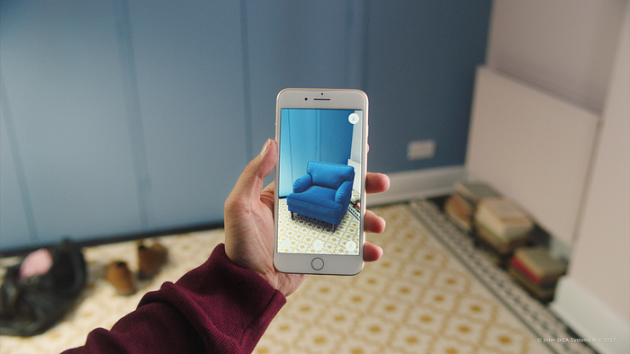
Augmented Reality (AR)
Object tracking identifies 2D objects and overlays virtual objects onto the natural world in AR applications.
https://www.comet.com/site/blog/an-introduction-to-object-tracking-in-computer-vision/

Slide 50

AR (Augmented Reality): Eulerian Video Magnification (2:55)
Notes:
Examples of Industrial applications in the next lecture

Slide 51
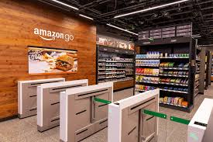
Computer Vision in Retail
Transforming Shopping Experiences
🛒
Autonomous Checkout
No cashiers needed
📦
Inventory Management
Real-time stock tracking
📊
Customer Analytics
Behavior patterns
🔒
Security & Loss Prevention
Theft detection
Amazon Go Example:
  • Uses hundreds of cameras with computer vision
  • Tracks what customers pick up and put back
  • Automatically charges customers when they leave

Slide 52

Image Manipulations: Mosaicking, Stitching, Panoramas (4:08)

Slide 53
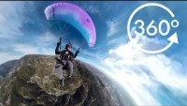
Spherical Cameras (3:48)
Notes:
Note navigation within the sphere using the YouTube widget or by dragging the screen with mouse. Notice stitches and other artifacts of forming a 360-view

Slide 54

Image Manipulations: Watermarking, Steganography (4:13)

